Slide 1
Population Aging and the Generational Economy: A Global Perspective
Ronald Lee and Andrew Mason
Lead authors and editors

Slide 2
We are inherently social, and are sustained not only by our own efforts, but also by transfers from those of others who support us directly or indirectly.
We humans could not make it through life alone and unaided. Yes, we work and support ourselves and accumulate assets for old age.
But before we are old enough to work, it is our parents who provide for us out of their earnings.
And as the life cycle stage of old age expands, we rely more and more on tax payers to support us through government programs.
Humans are inherently social, and are linked together both through private relationships and through public programs.
Often these links take the form of intergenerational transfers – flows of income from one generation to another that do not pass through the market and are something like gifts.
In fact, at each age we make up the gap between our labor income and our consumption in one of three ways:
assets, including homes, equities, and credit markets;
public transfers, including pensions, education, and health care;
and private transfers to rear our children or support our parents or receive support from them.

Slide 3
NTA is consistent with standard national accounts, but it adds the dimensions of age and of transfers, both public and private
National Transfer Accounts, or NTA for short, is a new set of methods to estimate these asset and transfer flows. NTA is consistent with standard national accounts but it goes beyond them in two important new ways.
First, it estimates transfers within families and households, between households, and through the public sector.
Second, it breaks down national accounts by age.
Both of these new dimensions are critical not only for understanding society and the economy, but also for understanding the way that changing population age distributions affect the economy.
NTA is comprehensive, in that it
covers all kinds of economic flows between generations, both market and non-market
Includes both rich industrial nations and poor nations.

Slide 4
From rapid population growth to population aging.
Not long ago, we worried about rapid population growth and the high number of children in Third World populations.
Then, as fertility began to decline in country after country, the share of children in the population dropped while the share of workers increased.
More workers and fewer dependents boosted per capita income growth.
But as the smaller generations made their way into the labor force, it grew more slowly while the number of elderly continued to grow rapidly. Population aging arrived, and brought new problems with it.
These days there are great concerns about the impact of rising numbers of elderly, concerns that
contribute to financial instability in some European countries
and limit the policy options for responding to the economic crisis.
But the public sector is only a fraction of the economy, and to understand the economics of aging we must also consider the private sector and its intergenerational links.

Slide 5
Population aging and the generational economy: A global perspective
Our new book is based on a large project that estimates National Transfer Accounts in 36 countries.
Each country has its own research team.
We have been working on the book for seven years.

Slide 6
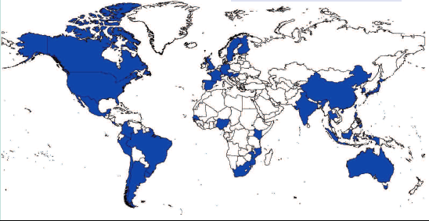
The geographic coverage of NTA and current members
NTA Members
Asia-Pacific | Americas | Europe | Africa
Australia | Argentina | Austria | Kenya
China | Brazil | Finland | Mozambique
India | Canada | France | Nigeria
Indonesia | Chile | Germany | Senegal
Japan | Colombia | Hungary | South Africa
Philippines | Costa Rica | Italy
South Korea | Jamaica | Slovenia
Taiwan | Mexico | Spain
Thailand | Peru | Sweden
Vietnam | United States
 | Uruguay

Slide 7
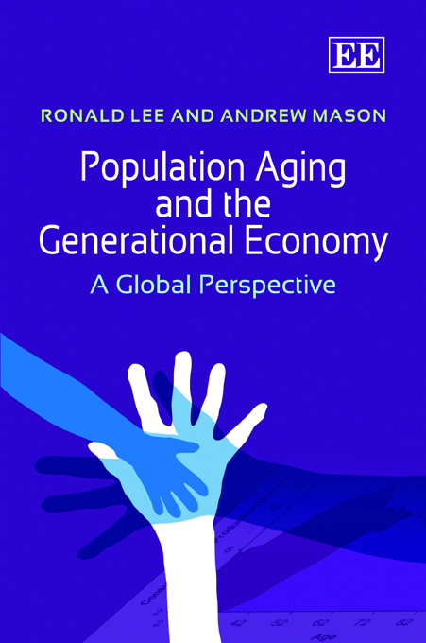
After more than a hundred articles by project members, the first book from the project is out.
It says Lee and Mason on the cover, but it reflects the efforts, inputs, and writing of dozens of researchers around the world who are on NTA country teams or who have assisted and trained country teams.
Here at this launch we have key NTA contributors Jorge Bravo, Sang-Hyop Lee and Hiro Ogawa.

Slide 8
This continuing effort has been supported by many funders
National Institute on Aging (NIA)
International Development Research Center (IDRC), Canada
UN Fund for Population Activities (UNFPA)
UN Population Division
East-West Center, Hawaii
Center for the Economics and Demography of Aging, UC Berkeley
Japan: MEXT.ACADEMIC FRONTIER
MacArthur Foundation
European Union
In-country support from governments and other funders in many countries.

Slide 9
National Transfer Accounts (NTA)
NTA describes the age patterns of economic activity and the economic relations between the generations. In this way, it illuminates the economic impacts of population change during the demographic transition and throughout the process of population aging.

Slide 10
Children are a heavy economic burden in many developing countries
High fertility in developing countries has led to very young populations.
A large portion of what adults are producing is going to meet the material needs of their children.
Most is going to meet basic needs like food, clothing, and housing.
Little remains for health and education for children.

Slide 11
Economic lifecycle flows for Nigeria, per capita values

Slide 12
Aggregate flows, Nigeria
Net cost of children (<25) is 87% of the total labor income of adults 25+.
Net cost of elderly is very small.

Slide 13
Fertility and the Cost of Children Selected NTA countries
Country | Total fertility rate | Net cost of children
Nigeria | 5.8 | 87%
Kenya | 5.1 | 62%
Philippines | 3.9 | 70%
India | 3.2 | 50%
United States | 2.1 | 30%
China | 1.7 | 19%
Germany | 1.3 | 44%
Japan | 1.3 | 25%
Note: Net cost of children is consumption less labor income of those under age 25 as a percentage of the labor income of those 25 and older.

Slide 14
Human Capital Spending, Nigeria
Only 20% of spending on children goes to human capital (health and education)

Slide 15
Net Cost of Children and Human Capital Spending
Country | Net cost of children 0-24 as a percent of labor income of 25 and older | Human capital spending as a percent of consumption by children 0-24
Nigeria | 87% | 20%
Kenya | 62% | 18%
Philippines | 70% | 17%
India | 50% | 16%
United States | 30% | 30%
China | 19% | 37%
Germany | 44% | 26%
Japan | 25% | 34%

Slide 16
Fertility and Human Capital Spending Selected NTA countries
Country | Total fertility rate | Human capital spending
Nigeria | 5.8 | 20%
Kenya | 5.1 | 18%
Philippines | 3.9 | 17%
India | 3.2 | 16%
United States | 2.1 | 30%
China | 1.7 | 37%
Germany | 1.3 | 26%
Japan | 1.3 | 34%
Note: Human capital spending is spending on education and health as a percentage of total consumption by those under 25 years of age.

Slide 17
Tradeoff between fertility and human capital spending, 23 NTA countries
Note: Human capital spending is years of labor income required for health and education to raise one child.

Slide 18
In countries with lower fertility . . .
Children claim a much smaller share of the nation’s production.
More can be devoted to raising human capital spending per child.
More can be used to raise standards of living and to reduce poverty.
More can be saved and invested in the future.
But low fertility eventually leads to populations with high rates of old-age dependency.

Slide 19
The US Economic Lifecycle, Aggregate Flows

Slide 20
US Economic Lifecycle, 65+
Labor income

Slide 21
Old-age Funding System, US
Asset-based flows
Labor income

Slide 22
Old-age Funding System, US
Funding of old-age consumption
Labor income 16.4%
Assets 58.3%
Transfers 25.2%
Public 31.9%
Private - 6.6%
Transfers
Asset-based flows
Labor income

Slide 23
Old-age Support System NTA Countries
Key tradeoff: transfers versus assets.
IN
US relies heavily on assets.
ID
US
MX
Heaviest reliance on transfers is in Europe.
DE
UY
Latin America and East Asia are similar in their reliance on transfers, but public dominates in LA and private important in EA.
CR
SI
BR
CN
HU

Slide 24
Concluding Remarks
High fertility and young age structure lead to a heavy economic burden.
Transition to low fertility is leading to populations with a high percentage of elderly.
Social and economic structures determine whether the elderly are an economic burden.
Elderly can be relatively self-reliant.
In doing so, their financial wealth and continued labor can raise standards of living for all.

